Slide 1
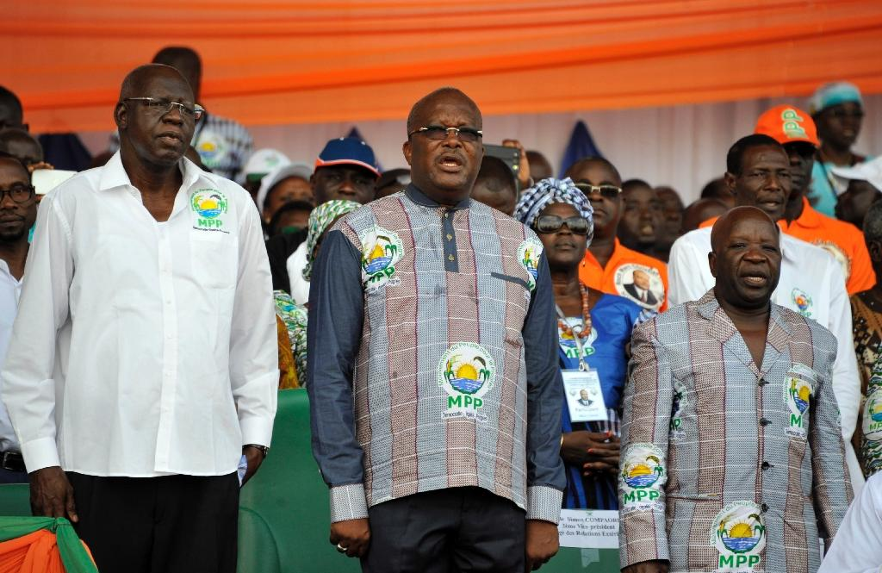
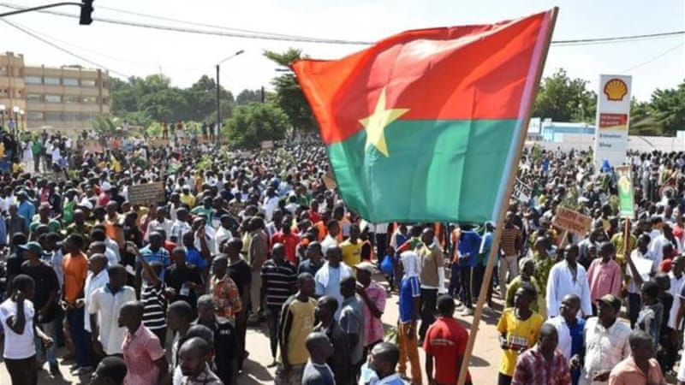
Who Defects?
Visualizing A Defection Cascade in Authoritarian BURKINA FASO

Slide 2
Research Question
Why do ruling elites remain loyal to dictators in some cases but not others?

Slide 3
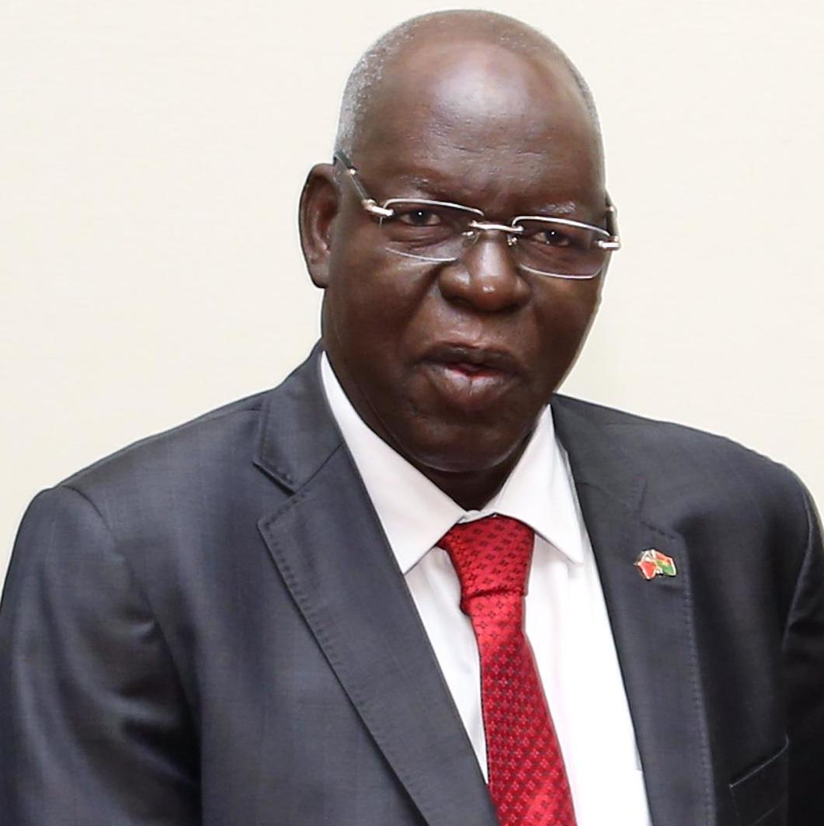
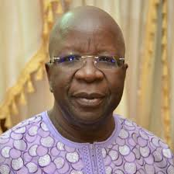
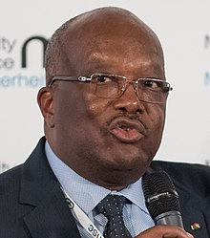
Revolution in Burkina Faso
After 27 years in power, autocrat Blaise Compaore was ousted from office in October 2014
75+ ruling party members defected in January 2014, including key figures Salif Diallo, Simon Compaore, and Roch Marc Kabore

Slide 4


Who Defected and Why?
Ruling party members learned to love democracy? (Honig and Andrews 2019)
More likely…regional or ethnolinguistic dynamics

Slide 5
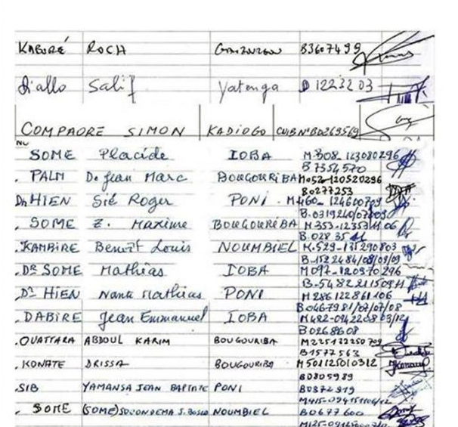
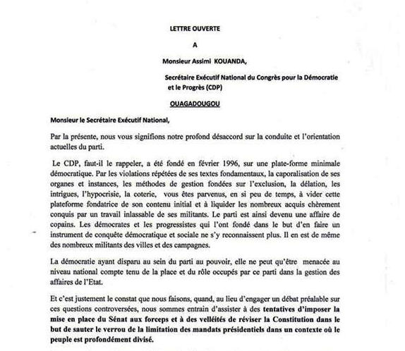

Data Sources

Slide 6
Data & Process
Collected defector data and data on relevant covariates by province
Provinces/regions
Urban/rural (cities w/ 50,000+ people)
Primary language and ethnicity (Afrobarometer)
% support for democracy and % support for ruling party (Afrobarometer 2008)
Manipulated and merged data from various sources in R
Then produced plots and maps in R and QGIS
Merged data with shapefile

Slide 7
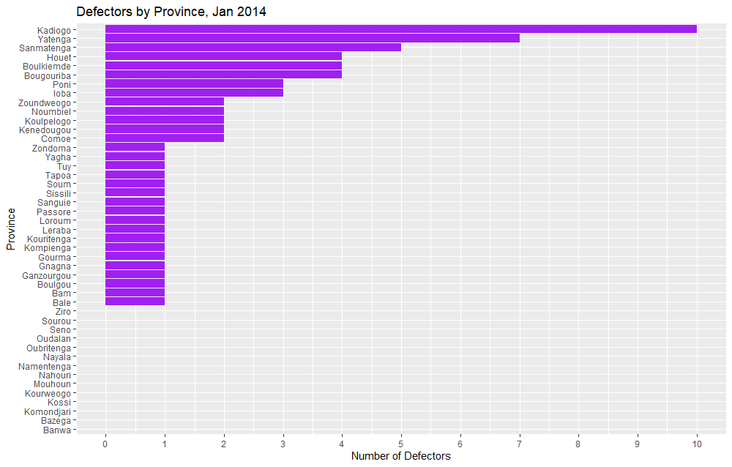
(Defections by Region)

Slide 8
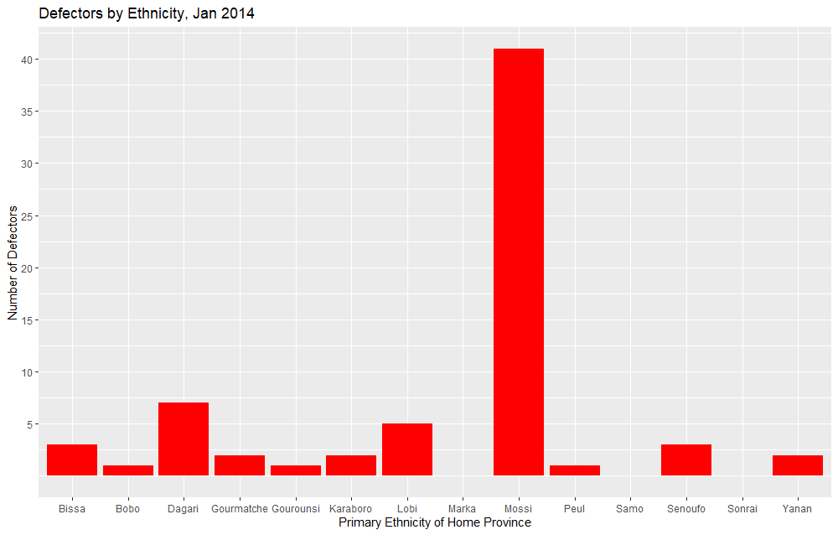
(Ethnicity)

Slide 9
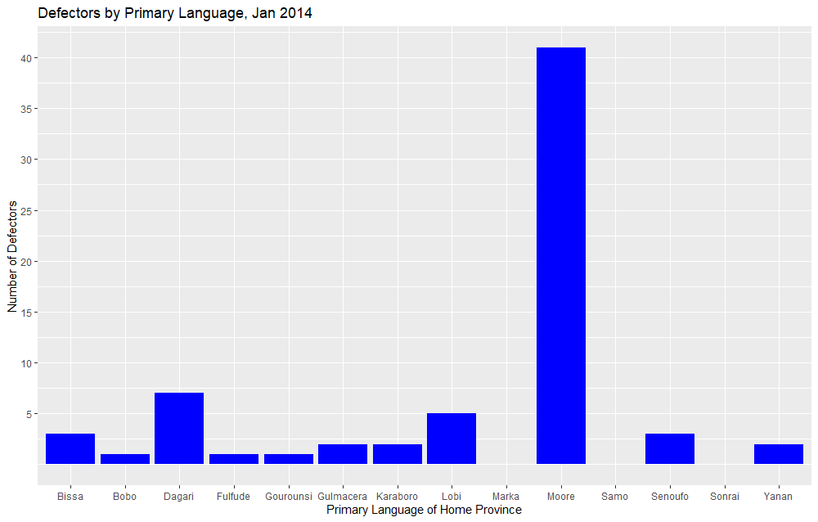
(Language)

Slide 10
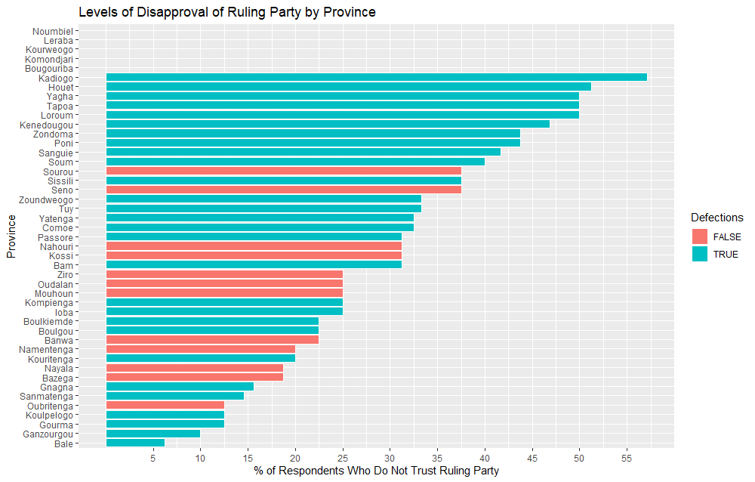
(Ruling Party Support)

Slide 11
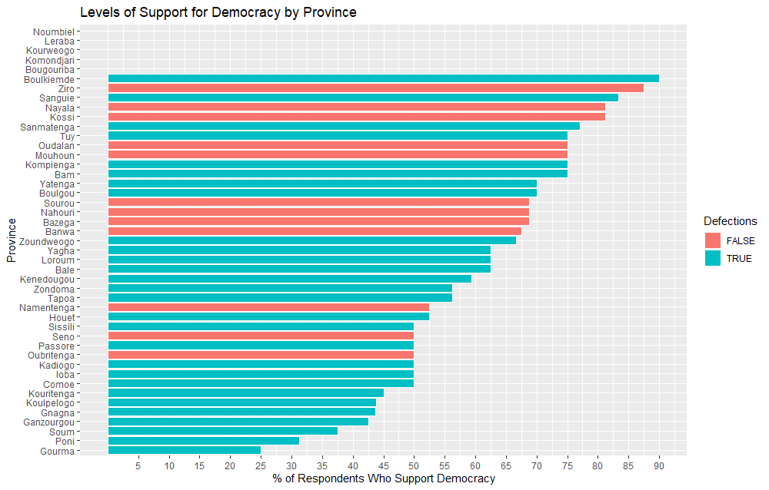
(Democracy)

Slide 12
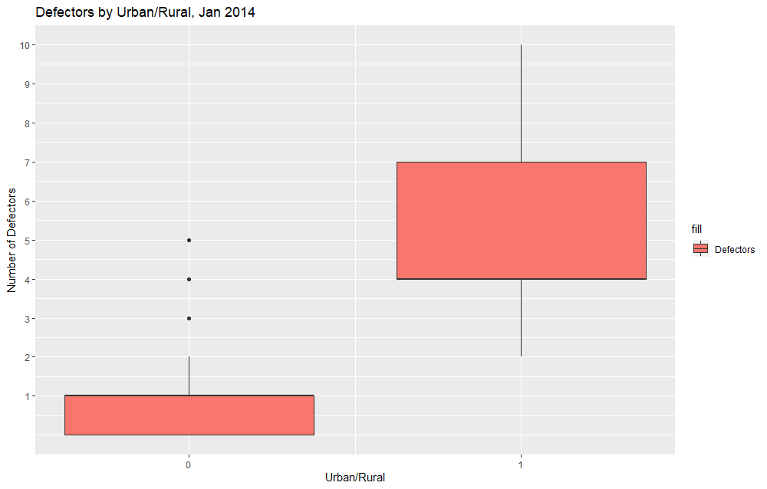
(Urban/Rural)

Slide 13
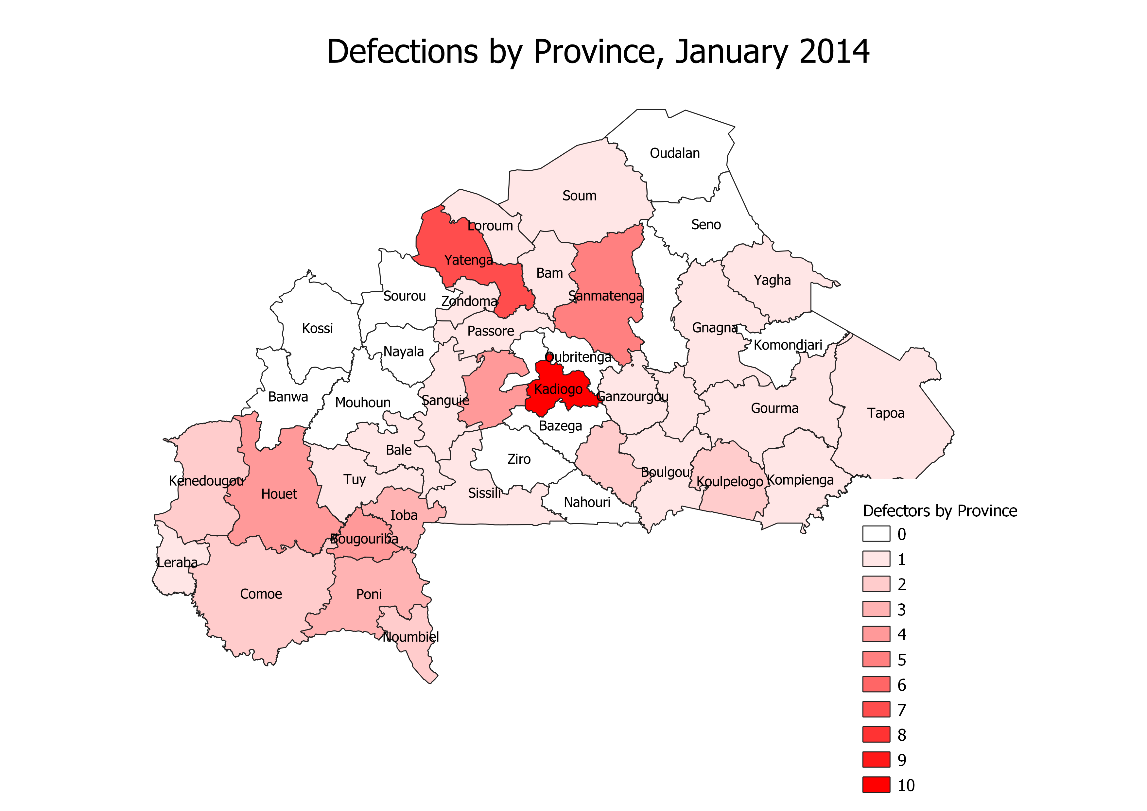
(Map of Defectors)

Slide 14
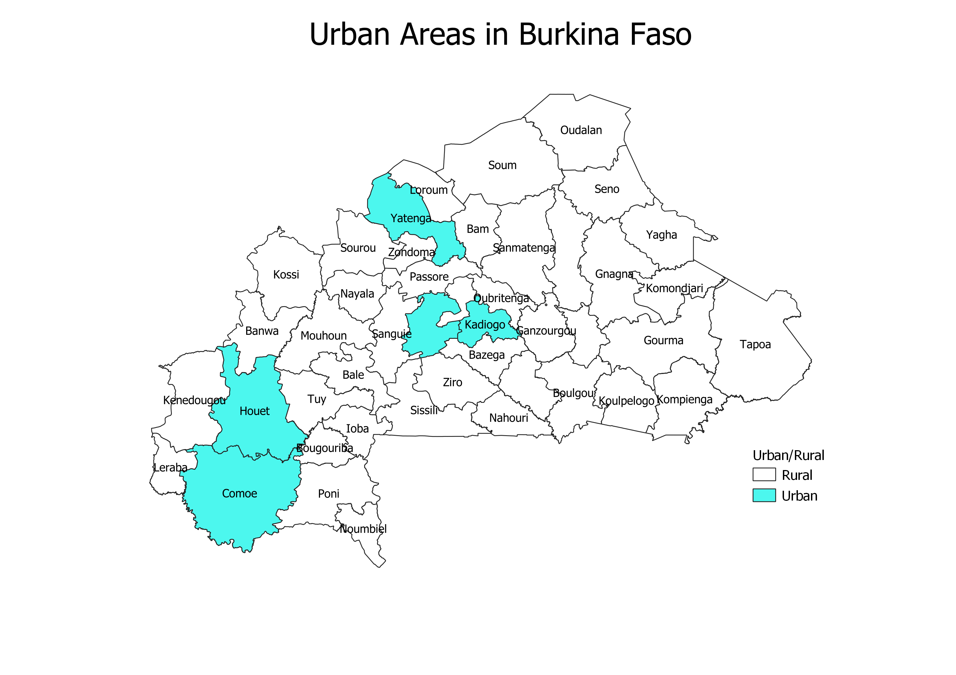
(Map by Urban/Rural)

Slide 15
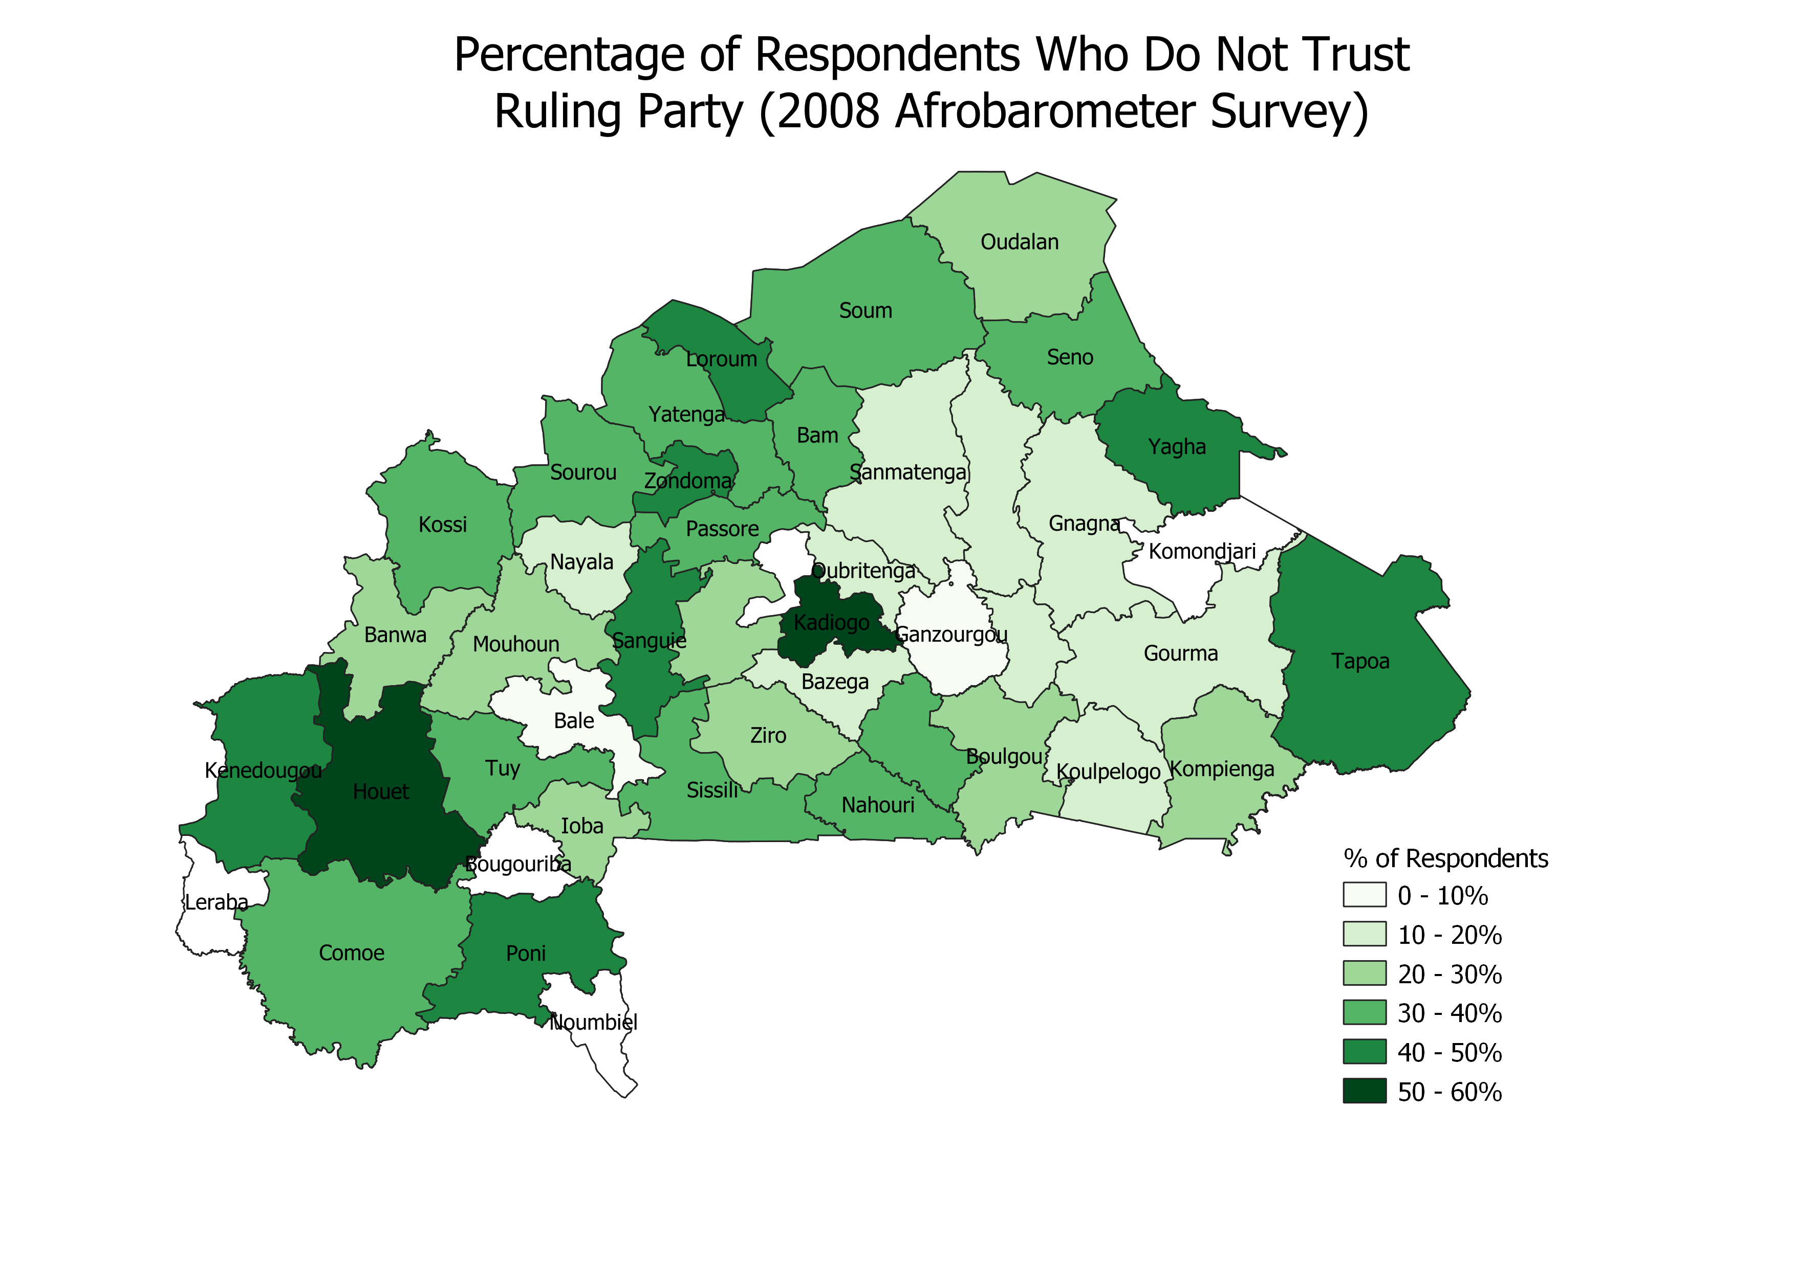
(Map by Urban/Rural)

Slide 16
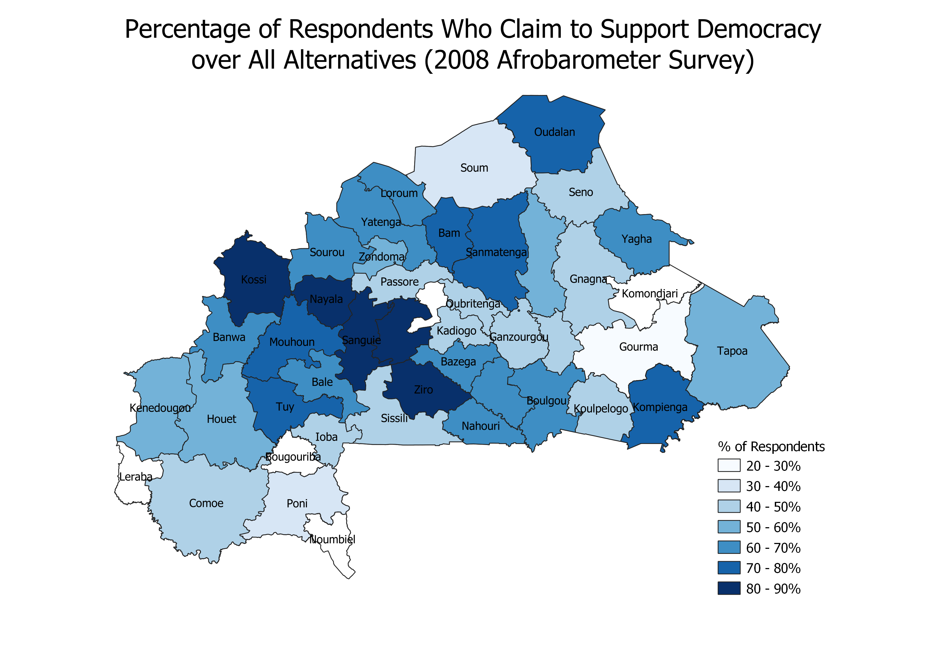
(Map by Urban/Rural)

Slide 17
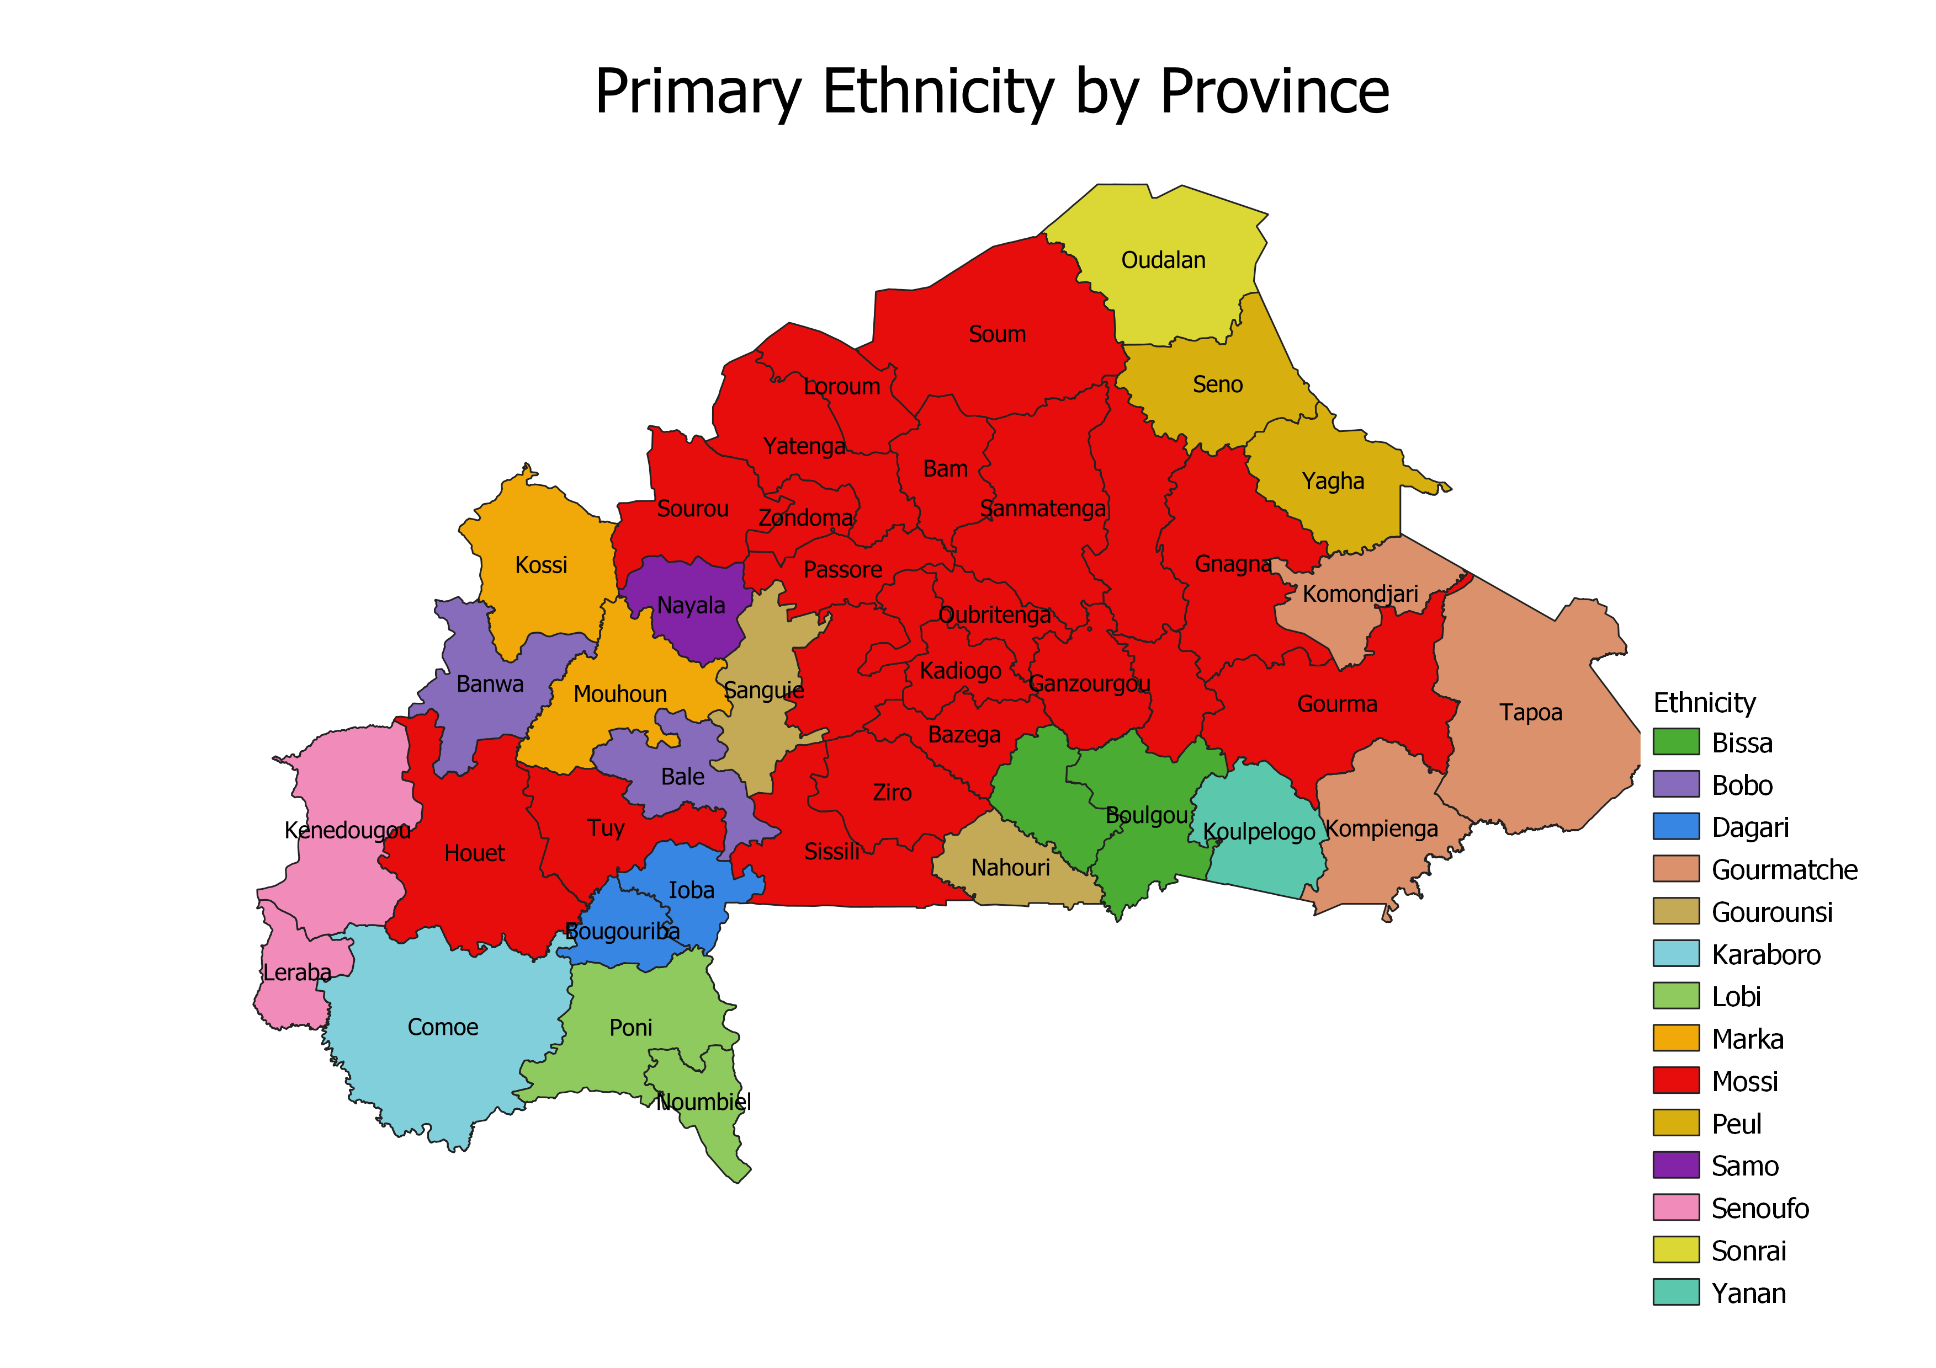
(Map by Urban/Rural)

Slide 18
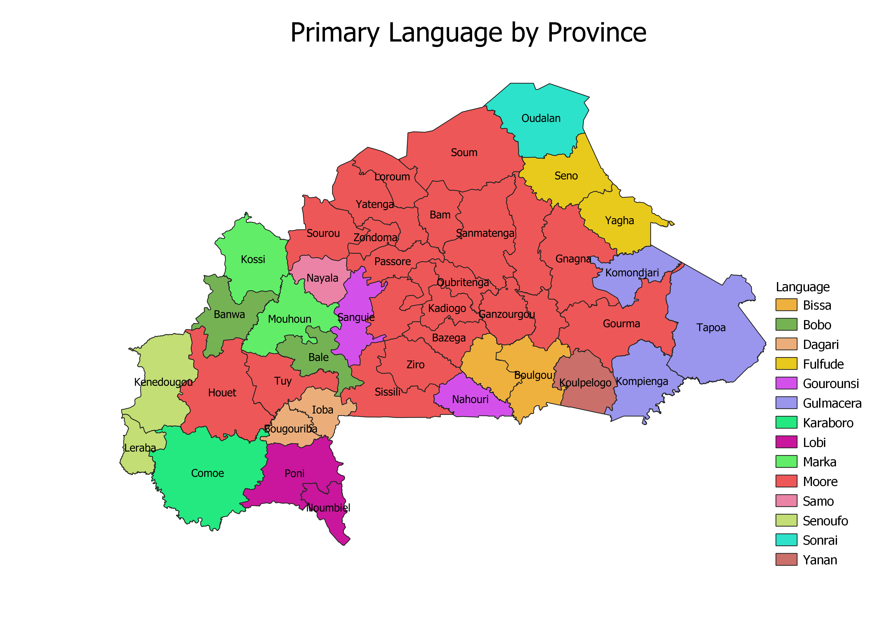
(Map by Urban/Rural)

Slide 19
Conclusions
Some Support for Ethnicity, Language, and Urban/Rural Variables
Limited Support for Support for Democracy and Support for Ruling Party Variables
Limitations:
Province, not Individual, Level Data
Lack Entire Universe of Data on Ruling Party Officials
Small Sample

